Slide 1
Azure Table Storage

Slide 2
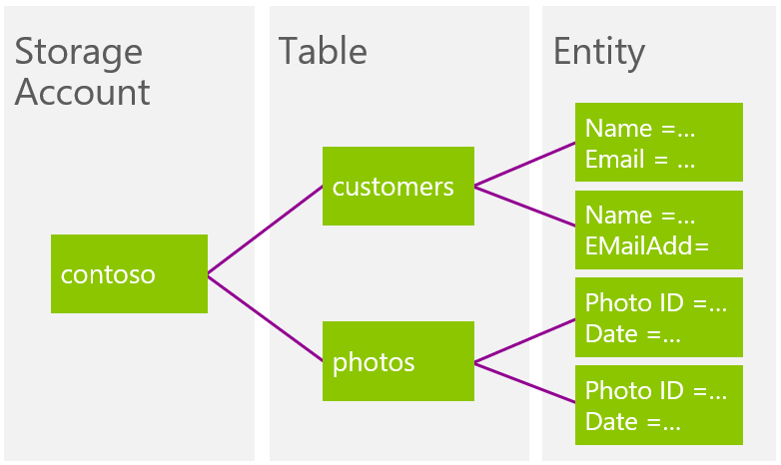
Azure Table Storage
Azure Table Storage is a highly scalable document-based NoSQL solution provided by Azure.
It is a sub-service under Azure Storage account service.
Storage account sits on top of the hierarchy.

Slide 3
A storage account can grow up to 500TiB (550 TB) in size.
Number of tables that can be added in Storage account is limited by the available size.
A table in a storage can grow up to 500TiB (550 TB) in size.
The maximum throughput on an Azure Storage Table that can be achieved is 2000 entities/second.
The maximum throughput on an Azure Storage account that can be achieved is 20,000 entities/second.
Uses RESTful HTTP-based Azure Management API to communicate with OData as standard for querying.

Slide 4
Available SDK(s) in a variety of languages (C#, Node.js, Java, PHP, F#, Go, Ruby, C++, PowerShell, Rest API)
Available authorization methods –
Account key (Admin access on the storage account)
Shared Access Signature (SAS)
Azure AD with RBAC roles.
Naming conventions for Azure Table storage –
Only lowercase letters allowed.
Name must be between 3-63 characters long.
Name may only contain letters, numbers and hyphens and no special characters.
Cannot have duplicate table names in storage account.

Slide 5
Entity
Tables store data as entities.
Tables use this format - http://<storage account>.table.core.windows.net/<table>
An entity is a collection of named properties and their values.
Entities are analogous to rows in a RDBMS setting.
Maximum size of single entity – 1 MiB
Entities are self-describing and schema less.

Slide 6
Properties
Each property is stored as a <name, typed value> pair.
Properties can be the standard .NET types (string, binary, bool, DateTime, GUID, int, int64, and double)
An entity can have a total of 255 properties and cannot exceed 1 MiB in size.
3 properties are system properties –
PartitionKey – Unique key to identify the partition
RowKey – Uniquely identifier for the entity
Timestamp – Helps with implementing Optimistic Concurrency, exposed as a HTTP ETag
PartitionKey and RowKey together help to uniquely identify any entity in a document.
PartitionKey and RowKey are indexed so that lookup using them is extremely fast.
PartitionKey and RowKey must not exceed 1 KiB in size.
We can define up to 252 user defined properties.

Slide 7
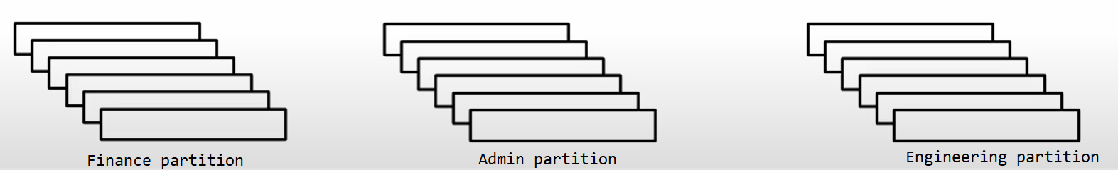
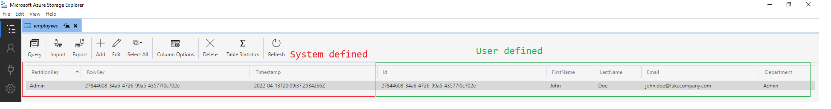
Designing Tables for Azure Table Storage
Partitioning / Sharding is done based on the needs on the domain. (E.g., Department)
Partition groups the entities into a logical group. Entities in the same partition will be stored together.
We should aim to add PartitionKey and RowKey in all the queries to make it more performant.

Slide 8
When to use Azure Storage Tables ?
Storing massive(in order of TiB) amounts of schema less data.
Data needs to be in JSON serializable format.
No need of joins.
Data is self – describing and denormalized.
OData queries support.

Slide 9
Azure Table Storage Encryption
Data at rest is encrypted using AES-256 symmetric key algorithm which is FIPS 140-2 compliant.
We can doubly encrypt our data by using –
Microsoft managed keys
Customer managed keys (DIY)
No additional cost is associated for encryption.

Slide 10
Azure Table Storage Pricing
Interactive pricing calculator for different azure regions can be viewed here.

Slide 11
Azure Storage Explorer
Electron.js based desktop tool to visualize table and perform CRUD and admin operations on it.
Download it here.

Slide 12
Azure Table Storage C# SDK
Microsoft recommends Azure Table Storage client library v12 for .NET
Install-Package Azure.Data.Tables -Version 12.5.0
Register the TableClient as Singleton lifetime in .NET Core IoC container.
This SDK is compatible both with Azure Table Storage and Azure Cosmos DB (Table API).
Custom classes must implement ITableEntity interface.

Slide 13
Demo

